Slide 1
Optimizing Information Retrieval: A Hybrid Model Leveraging MAR and RAPTOR Frameworks
George Washington University
Prepared by: Timur Abdygulov
Supervised by Amir H. Jafari
December 10, 2024
Notes:
Recursive Abstractive Processing for Tree-Organized Retrieval (RAPTOR)

Slide 2
Table of Contents
Introduction
Methodology Overview
Naive RAG
MAR
RAPTOR
HYBRID rag
Dataset Description
Categorizing Biomedical Queries
Frequency of Biomedical Queries
Embedding Model Evaluation
Embedding Resource Utilization
Results
Discussion
Conclusion

Slide 3
Introduction
Retrieval-Augmented Generation (RAG):
Combines retrieval mechanisms with large language models (LLMs).
Enhances contextual understanding and reasoning capabilities.
Key Challenges in Retrieval Systems:
Limited adaptability for dynamic queries.
Poor handling of multi-hop reasoning and long-context synthesis.
Existing Models:
MAR: Excels at static memory recall but struggles with evolving tasks.
RAPTOR: Effective for dynamic and hierarchical reasoning but lacks memory persistence.
Contribution:
Hybrid Model integrates MAR’s memory with RAPTOR’s hierarchical reasoning.
Balances static recall and dynamic adaptability for diverse query challenges.
Notes:
Retrieval systems are essential for navigating vast amounts of unstructured data. However, they face significant challenges:
Traditional systems struggle with complex queries requiring multi-hop reasoning and adaptability.
MAR excels at static recall but lacks flexibility for dynamic tasks.
RAPTOR handles dynamic, multi-hop queries effectively but lacks persistent memory for recalling historical information.
These limitations prompted the development of a Hybrid Model, combining MAR's memory-driven retrieval with RAPTOR's hierarchical reasoning. The goal is to create a scalable, adaptable framework capable of addressing diverse retrieval challenges.
The rise of unstructured data challenges traditional retrieval systems.
RAG frameworks enhance retrieval with LLM integration.
Study explores Naive RAG, MAR, RAPTOR, and a Hybrid Model.
Focus: Combining memory-driven retrieval with hierarchical reasoning.

Slide 4
Methodology Overview
Evaluation of Naive RAG, MAR, RAPTOR, and Hybrid Model.
Integration with vector stores and generative models for response synthesis.
Focus on modularity and extensibility.
Hyperparameter | Value/Default | Description
chunk_size | 1000 | The maximum size of text chunks for splitting documents.
chunk_overlap | 115 | The number of overlapping characters between consecutive text chunks.
embedding_dim | 1024 | Dimension of the embeddings generated by the model.
batch_size | 16 (embedding), 50 (indexing) | Batch size for document processing during embedding generation or indexing.
max_documents | Derived dynamically | The maximum number of documents stored, based on space and model embedding size.
avg_document_size | 1000 | Average size of documents in bytes, used for storage estimation.
Notes:
Study evaluates four systems: Naive RAG, MAR, RAPTOR, and the Hybrid Model. All systems integrate a vector store for semantic search and a generative language model for response synthesis. Table below shows the key configurations and parameters designed to balance retrieval efficiency and response quality throughout all 4 models.

Slide 5
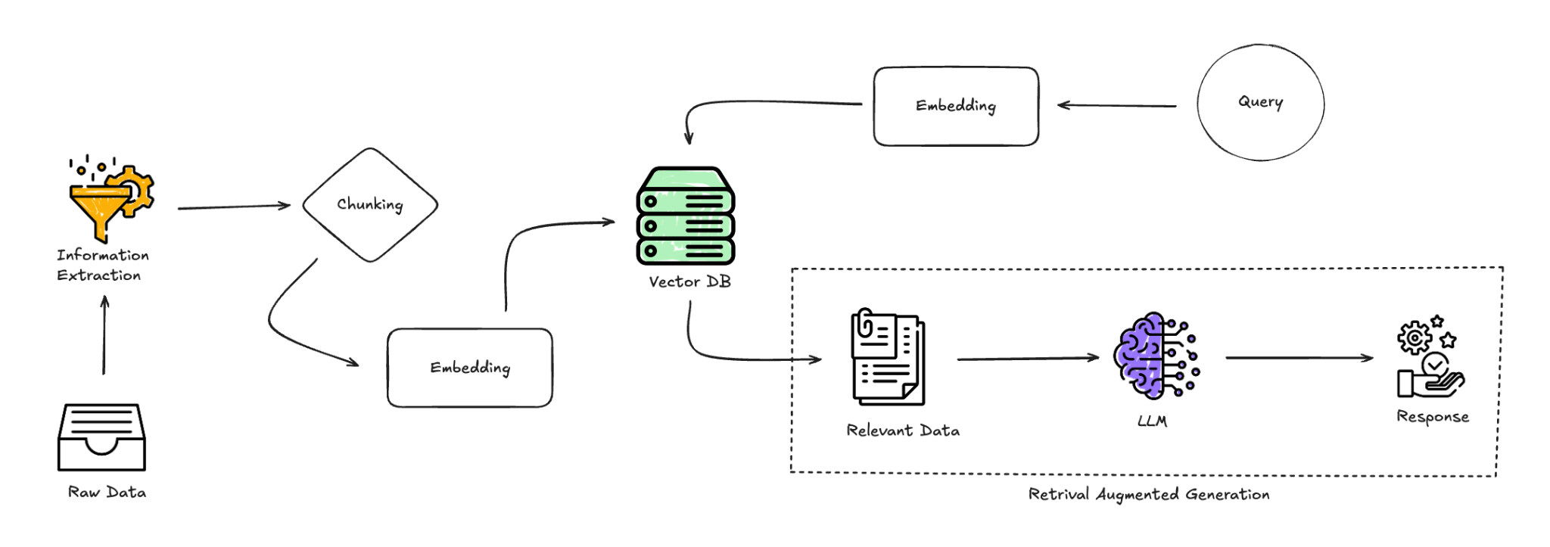
Naive RAG
Baseline RAG framework.
Straightforward retrieval-to-generation pipeline.
Effective for static, simple queries but limited in dynamic adaptability.
Notes:
Naive RAG serves as the baseline. It follows a straightforward retrieval-to-generation pipeline, where documents are embedded, matched, and passed to a language model for response synthesis. While simple, it lacks features like memory or advanced reasoning capabilities. Here is a diagram of its workflow.

Slide 6
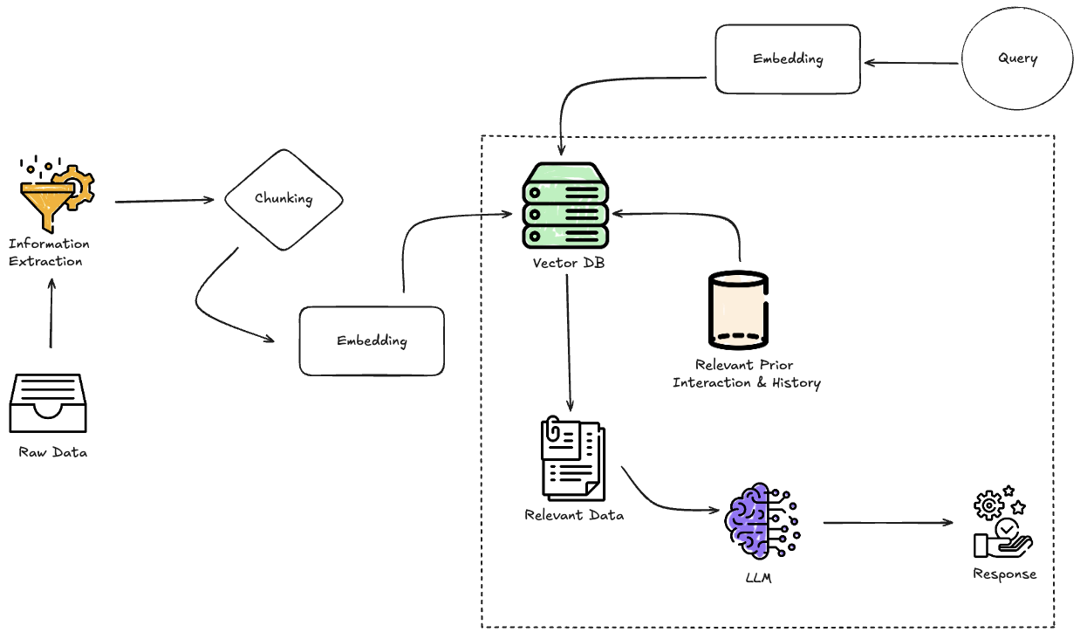
Memory-Augmented Retrieval (MAR)
Adds a memory database for recurring queries.
Efficient for static tasks, limited for evolving contexts.
Notes:
MAR enhances Naive RAG by incorporating a memory database to handle static, frequently recurring queries. It checks the memory first and only falls back to the vector store if no match is found. This makes it efficient for static tasks but limits its adaptability to dynamic or multi-layered queries.

Slide 7
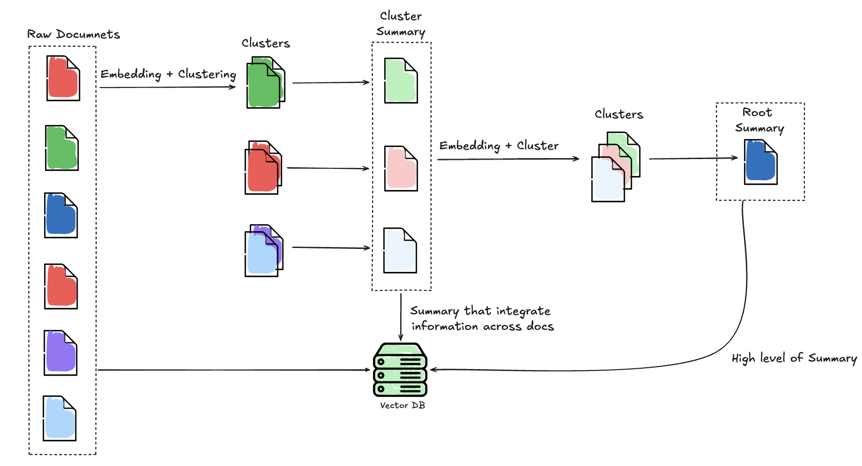
Recursive Abstractive Processing for Tree-Organized Retrieval (RAPTOR)
Hierarchical document organization for multi-hop reasoning.
Semantic clustering enhances contextual synthesis.
Limited by lack of memory.
Notes:
RAPTOR organizes data hierarchically, enabling efficient multi-hop reasoning by traversing clusters of semantically related information. Its ability to structure data hierarchically makes it effective for complex tasks. However, it lacks memory persistence, which limits its performance in recalling historical queries.

Slide 8
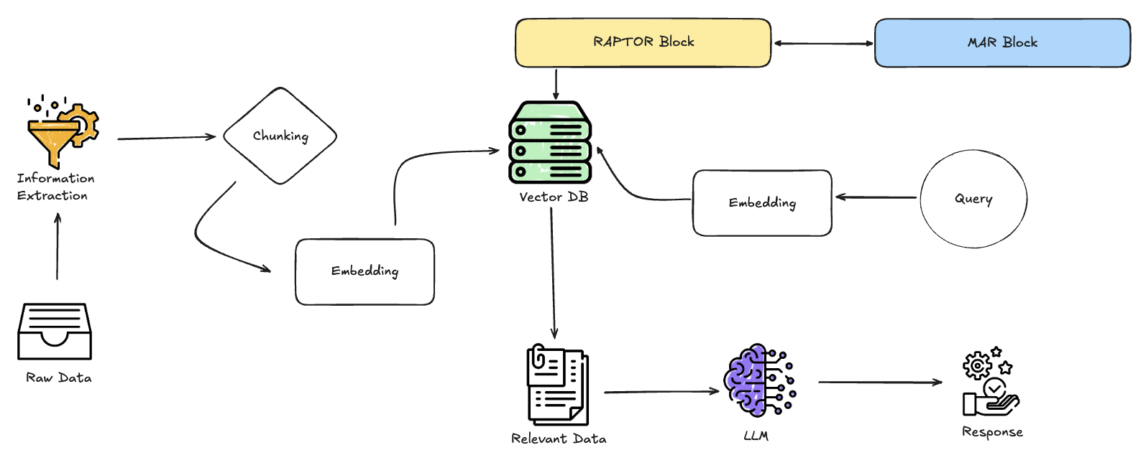
Hybrid Model (MAR + RAPTOR)
Combines MAR's memory with RAPTOR's reasoning.
Handles static, dynamic, and multi-layered queries.
Notes:
The Hybrid Model combines MAR's memory-driven retrieval with RAPTOR's hierarchical reasoning. It uses a dynamic similarity threshold to route queries through MAR or RAPTOR, depending on their nature. This integration enhances flexibility and adaptability across a range of query types.

Slide 9
Retrieval System: ChromaDB
Role in Retrieval Systems:
Facilitates efficient semantic search through embedding-based matching.
Acts as the backbone for storing and retrieving high-dimensional vector representations of documents.
Chosen System: ChromaDB
Scalable and low-latency query processing.
Supports dense, hybrid (dense + keyword), and multimodal retrieval.
Key Features of ChromaDB:
Seamless integration with frameworks like LangChain and modern embedding models.
Handles high-dimensional embeddings (e.g., 1024 dimensions).
Optimized for hybrid retrieval methods (semantic and keyword-based).
Advantages:
Scalability for large datasets.
High-speed processing with minimal latency.
Compatibility with adaptive and hierarchical retrieval methods.
Notes:
Vector stores are essential for efficient semantic search, storing high-dimensional document embeddings for quick retrieval.
We used ChromaDB for its scalability, low latency, and hybrid retrieval capabilities, combining semantic and keyword-based searches.
ChromaDB integrates with frameworks like LangChain and supports modern embedding models, ensuring precision and speed for large-scale datasets.

Slide 10
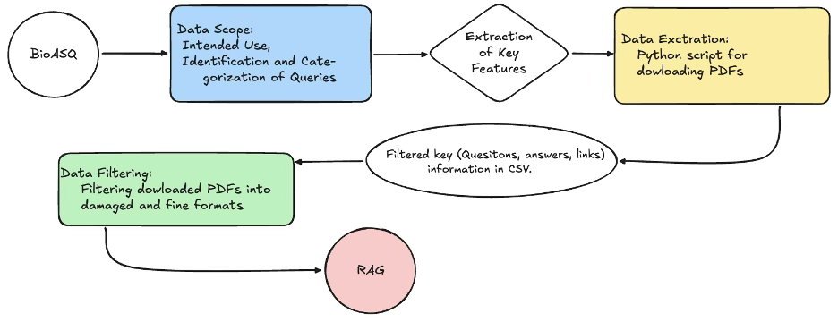
Dataset Description
BioASQ biomedical dataset.
Query types: Static, Dynamic, and Multi-layered.
Thorough data preprocessing for consistency.
Notes:
To evaluate performance, used the BioASQ biomedical dataset, which categorizes queries into Static, Dynamic, and Multi-layered. This diversity ensures a comprehensive assessment of the systems’ capabilities, ranging from straightforward factual questions to multi-hop reasoning tasks.

Slide 11
Categorized Biomedical Queries
ID | Question | Category
1 | Is Hirschsprung disease a Mendelian or a multifactorial disorder? | M
2 | List signaling molecules (ligands) that interact with the receptor EGFR? | S
3 | Are long non-coding RNAs spliced? | M
4 | Is RANKL secreted from the cells? | S
5 | Which miRNAs could be used as potential biomarkers for epithelial ovarian cancer? | M
6 | Which acetylcholinesterase inhibitors are used for treatment of myasthenia gravis? | S
7 | Has Denosumab (Prolia) been approved by FDA? | D
8 | Which are the different isoforms of the mammalian Notch receptor? | S
9 | Orteronel was developed for treatment of which cancer? | D
10 | Is the monoclonal antibody Trastuzumab (Herceptin) of potential use in the treatment of prostate cancer? | D
11 | Which are the Yamanaka factors? | S
12 | Where is the protein Pannexin1 located? | S
13 | Which currently known mitochondrial diseases have been attributed to POLG mutations? | M
Static Queries involve retrieving straightforward, factual information that relies on pre-existing, often unchanging knowledge.
Dynamic Queries require contextual reasoning and the ability to handle evolving information, such as updates to regulatory statuses or therapeutic applications.
Multi-Layered Queries demand evidence aggregation and multi-hop reasoning, where answers must be synthesized across multiple sources or involve complex reasoning steps.
A total of 47 PDFs were used

Slide 12
Frequency of Biomedical Queries
ID | Question | Frequency
1 | Is Hirschsprung disease a Mendelian or a multifactorial disorder? | 2
2 | List signaling molecules (ligands) that interact with the receptor EGFR? | 4
3 | Are long non-coding RNAs spliced? | 4
4 | Is RANKL secreted from the cells? | 3
5 | Which miRNAs could be used as potential biomarkers for epithelial ovarian cancer? | 6
6 | Which acetylcholinesterase inhibitors are used for treatment of myasthenia gravis? | 2
7 | Has Denosumab (Prolia) been approved by FDA? | 2
8 | Which are the different isoforms of the mammalian Notch receptor? | 2
9 | Orteronel was developed for treatment of which cancer? | 3
10 | Is the monoclonal antibody Trastuzumab (Herceptin) of potential use in the treatment of prostate cancer? | 7
11 | Which are the Yamanaka factors? | 7
12 | Where is the protein Pannexin1 located? | 4
13 | Which currently known mitochondrial diseases have been attributed to POLG mutations? | 2

Slide 13
Embedding Model Evaluation
High-performance embeddings offer accuracy at higher computational costs.
Lightweight embeddings balance efficiency and speed.
Embedding Model | Top 1 Accuracy (%) | Top 10 Accuracy (%)
bert-large-nli | 75.0 | 87.5
instructor-xl | 87.5 | 87.5
msmacro | 87.5 | 87.5
mxbai-embed-large | 87.5 | 87.5
roberta-base | 37.5 | 87.5
roberta-large | 62.5 | 62.5
dunzhang/stella_en_1.5B_v5 | 1 | 80.3
nvidia/NV-Embed-v2 | 1 | 80.5
Notes:
Embedding models play a crucial role in retrieval. High-performance models offer superior accuracy but are computationally expensive. Lightweight models are more resource-efficient, making them suitable for simpler tasks. Table 7 compares the accuracy of these embeddings for Top-1 and Top-10 retrievals.

Slide 14
Embedding Resource Utilization
High-performance embeddings require substantial GPU memory.
Lightweight models suitable for simpler tasks.
Model Name | GPU Memory Used (GB) | Total Parameters (Millions) | Loaded in 8-bit
mixedbread-ai/mxbai-embed-large-v1 | 1.25 | 335.14 | No
dunzhang/stella_en_1.5B_v5 | 3.48 | 1543.27 | Yes
dunzhang/stella_en_1.5B_v5 | 9.25 | 1543.27 | No
sentence-transformers/all-MiniLM-L6-v2 | 0.08 | 22.71 | No
meta-llama/Meta-Llama-3-8B-Instruct | 10.42 | 8030.26 | Yes
Notes:
Resource utilization is a critical factor when selecting embeddings. High-performance embeddings consume substantial GPU memory, limiting scalability, whereas lightweight models are faster and less demanding. Table 8 illustrates these trade-offs in computational resources.

Slide 15
Results Summary
Hybrid Model achieves balanced performance across query types.
MAR excels in static recall; RAPTOR in multi-hop reasoning.
Embedding strategies influence performance and scalability.
MAR:
Answered: 11 out of 13 questions
Very Close to Ideal: 7
Correct Answer: 6
RAG:
Answered: 11 out of 13 questions
Very Close to Ideal: 7
Correct Answer: 5
RAPTOR:
Answered: 8 out of 13 questions
Very Close to Ideal: 3
Correct Answer: 3
RAPTOR+Memory:
Answered: 10 out of 13 questions
Very Close to Ideal: 6
Correct Answer: 5
Notes:
Let’s summarize the results. Naive RAG is simple and effective for basic queries but struggles with complexity. MAR excels at static memory recall, while RAPTOR is best suited for dynamic, multi-hop reasoning. The Hybrid Model combines these strengths, achieving balanced performance across static, dynamic, and multi-layered queries. However, it also faces challenges with ambiguous inputs and resource-heavy embeddings.

Slide 16
Question | Ideal Answer | MAR Answer | RAG Answer | RAPTOR Answer | Hybrid Answer
Is Hirschsprung disease a Mendelian or a multifactorial disorder? | Hirschsprung disease is both Mendelian and multifactorial, depending on the context. | ✅ Matches ideal answer | ✅ Matches ideal answer | ❌ Incorrect | ✅ Matches ideal answer
List signaling molecules (ligands) that interact with the receptor EGFR? | The 7 EGFR ligands are EGF, BTC, EPR, HB-EGF, TGF-α, AREG, and EPG. | ✅ Matches ideal answer | ✅ Matches ideal answer | ✅ Matches ideal answer | ✅ Matches ideal answer
Are long non-coding RNAs spliced? | Yes, long non-coding RNAs are spliced through the same pathway as mRNAs. | ✅ Matches ideal answer | ✅ Matches ideal answer | ❌ Unclear or incomplete answer | ❌ Unclear or incomplete answer
Is RANKL secreted from the cells? | Yes, RANKL is secreted by osteoblasts. | ✅ Matches ideal answer | ❌ Does not mention secretion | ❌ Incomplete answer | ✅ Matches ideal answer
Which miRNAs could be used as potential biomarkers for epithelial ovarian cancer? | miR-200a, miR-100, miR-141, miR-200b, miR-200c, miR-203, etc. | ✅ Matches ideal answer | ❌ Partial match | ❌ Partial match | ✅ Matches ideal answer
Which acetylcholinesterase inhibitors are used for treatment of myasthenia gravis? | Pyridostigmine and neostigmine. | ✅ Matches ideal answer | ✅ Matches ideal answer | ✅ Matches ideal answer | ✅ Matches ideal answer
Has Denosumab (Prolia) been approved by FDA? | Yes, approved by the FDA in 2010. | ❌ Not answered | ❌ Not answered | ✅ Matches ideal answer | ❌ Not answered
Which are the different isoforms of the mammalian Notch receptor? | Notch-1, Notch-2, Notch-3, Notch-4. | ❌ Not answered | ❌ Not answered | ❌ Not answered | ❌ Not answered
Orteronel was developed for treatment of which cancer? | Castration-resistant prostate cancer. | ✅ Matches ideal answer | ❌ Not answered | ❌ Incorrect | ✅ Matches ideal answer
Is the monoclonal antibody Trastuzumab (Herceptin) of potential use in the treatment of prostate cancer? | Controversial, but it can be used in HER2 overexpressing prostate cancer. | ✅ Matches ideal answer | ✅ Matches ideal answer | ❌ Incorrect | ❌ Not answered
Which are the Yamanaka factors? | OCT4, SOX2, MYC, and KLF4 transcription factors. | ✅ Matches ideal answer | ✅ Matches ideal answer | ✅ Matches ideal answer | ✅ Matches ideal answer
Where is the protein Pannexin1 located? | Localized to the plasma membranes. | ✅ Matches ideal answer | ✅ Matches ideal answer | ✅ Matches ideal answer | ✅ Matches ideal answer
Which currently known mitochondrial diseases have been attributed to POLG mutations? | Recessive PEO and MNGIE. | ❌ Partial match | ❌ Partial match | ❌ Partial match | ❌ Partial match

Slide 17
Discussion
Hybrid Model mitigates trade-offs between memory and reasoning.
Embedding selection critical to balancing accuracy and scalability.
Limitations include semantic clustering errors and resource demands.
Notes:
The Hybrid Model mitigates trade-offs by integrating memory and reasoning capabilities. Embedding strategies are central to optimizing performance, but challenges like clustering errors and computational demands remain. Future work should focus on adaptive clustering, multimodal retrieval, and scalable embedding strategies.

Slide 18
Conclusion
Hybrid Model: A robust solution for diverse retrieval tasks.
Combines strengths of MAR and RAPTOR.
Future directions: Adaptive clustering, multimodal retrieval, and dynamic embeddings.
Notes:
In conclusion, the Hybrid Model offers a promising solution for diverse retrieval tasks. By combining MAR and RAPTOR, it addresses the limitations of individual systems, achieving balanced adaptability. Future advancements could extend its applications to multimodal retrieval and improve its efficiency.

Slide 19
Acknowledgments
Meet Daxini in help me with evlaution of embeddign models for stella and nvidai as well as calculating Resource Utilization of models

Slide 20
Thank you

